Slide 1
Database System
Nasreen akhtar
FAST-NU
Chiniot-Faisalabad campus

Slide 2
Week 1
Data models, Schema and Instances, Three-Schema architecture, Data Independence
Database languages and interface
The Database system Environment, Centralized and client/Server architecture for DBMSs.
Classification of DBMS

Slide 3
History of database
First-generation
Hierarchical and Network
Second generation
Relational
Third generation
Object Relational
Object-Oriented

Slide 4
Data Models
Data abstraction refers to hiding the of details of data organization and storage.
Data Independence
Physical representation and location of data and the use of that data are separated
The application doesn’t need to know how or where the database has stored the data, but just how to ask for it
Moving a database from one DBMS to another should not have a material effect on application program
Recording, adding fields, etc. in the database should not affect applications

Slide 5
Data Models
Data model A collection of concepts to describe the structure of a database, and certain constraints that the database should obey.
A model is an abstraction process that hides details
Data modeling is used for representing entities of interest and their relationship in the database.
The structure of a database includes data types, relationships, and constraints that should hold for the data.
Most data models also include a set of basic operations for specifying retrievals and updates on the database.
The data model specify dynamic aspects or behavior to specify valid define users operations.
For example COMPUTE GPA, grade

Slide 6
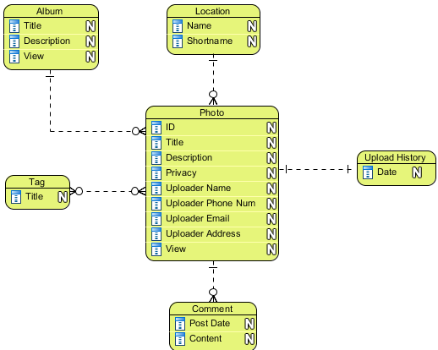
Categories of data models
High-level or conceptual data models
Use Entity-Relationship(ER) Model
use concepts such as entities, attributes, and relationships.
An entity represents a real-world object or concept, such as an employee, project, student.
An attribute represents some property of interest that further describes an entity, such as the employee's name or salary.
A relationship among two or more entities represents an association among two or more entities, for example, a works-on relationship between an employee and a project.

Slide 7
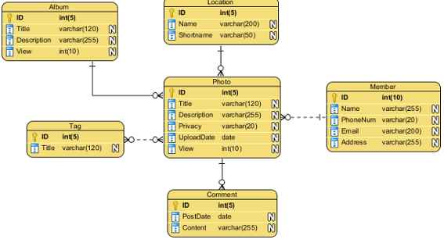
Categories of data models
low-level or physical data model
provides concepts that describe the details of how
data is stored in the computer model.
Representational /logical data model
It is between High level & Low level data model
Hide many details of data storage but can be implemented on a computer system in a direct way.
Frequently used in traditional DBMS including relational data model as well as legacy data model the network and hierarchical data model.

Slide 8
Categories of data models
Object data model
data models as a new family of higher-level implementation data models that are closer to conceptual data model.

Slide 9
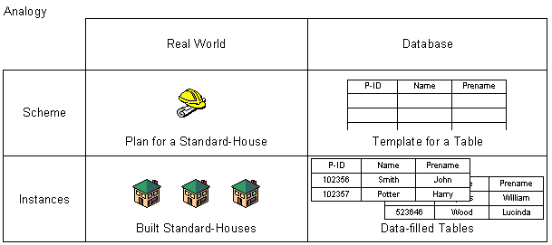
Schema and instances
Design or description of database is called schema.
It defines how the data is organized and how the relations among them are associated.
It formulates all the constraints that are to be applied on the data.
The database scheme is defined during the database design process and changes very rarely afterwards.
The data stored in database at a particular moment of time is called instance or state of database.

Slide 10
Database State
Every update operation changes the database from one state to another.
The Schema is sometimes is called the intension, and the database state an extension of the schema.

Slide 11
Three Schema Architecture
There are three level of schema.
Confirm by American National Standard Institute and Standard Planning and Requirement Committee
Also called ANSI/SPARC three level architecture

Slide 12
Three Schema Architecture
Internal Level Schema:
describes the physical storage structure of the database.
The internal schema uses a physical data model and describes the complete details of data storage and access paths for the database.
Conceptual Level Schema:
Describes the structure of the whole database for a community of users.
Hides the details of physical storage structures and concentrates on describing entities, data types, relationships, user operations, and constraints.
A representational data model is used to describe the conceptual schema when a database system is implemented.

Slide 13
Three Schema Architecture
External Level Schema:
includes a number of external schemas or user views.
Each external schema describes the part of the database that a particular user group is interested in and hides the rest of the database from that user group.
Each external schema is typically implemented using a representational data model, possibly based on an external schema design in a high level data model.
Mapping: The processes of transforming requests and results between levels are called mappings.

Slide 14
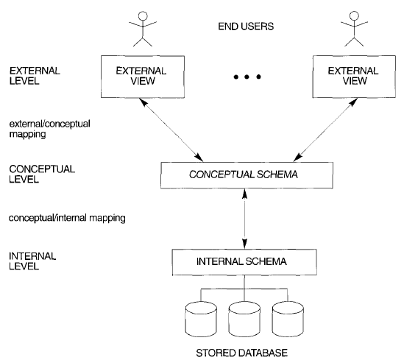
Three Schema Architecture

Slide 15
Data Independence
The ability to modify a scheme definition in one level without affecting a scheme definition in a higher level is called data independence. 1. Logical data independence
The ability to modify the conceptual scheme without having to change external schema or application program.
Usually done when logical structure of database is altered (change constraints, expand and reduce data base). 2. Physical data independence
The ability to modify the physical scheme without having to change conceptual schema.
Internal schema may be needed to reorganize physical files and improve performance.
For example by creating additional access structure- to improve the performance of update and retrieval.

Slide 16
Database languages
DDL – the data definition language, used by database developer to define the conceptual and internal schemas.
The DBMS has a DDL compiler to process DDL statements in order to identify the schema constructs, and to store the description in the catalogue.
Create command is used create table;
Alter command is used to alter table, columns, constraints and data types.
Drop command is used to drop a column, database, table or constraints

Slide 17
Database languages
DML , Data manipulation language is used to manipulate database. Manipulation operation includes insertion, deletion and updating and selection of data in database
DCL Data Control language: USE to assign privileges to different user to access database objects

Slide 18
Centralized and Client Server Architectures for DBMSs
Centralized DBMS Architecture
Used mainframes to provide main processing for user application programs, and DBMS functionality
User accessed systems via computer terminals that only provided display capabilities, with no processing capabilities.
All processing was performed remotely on the computer system, and only display information was sent to the terminals, connected via a network.

Slide 19
Centralized and Client Server Architectures for DBMSs
Terminals
Display
Monitor
Display
Monitor
Display
Monitor
Network
Mainframe
SOFTWARE
(Application Programs, DBMS, Text Editors, Compilers etc)
HARDWARE
(CPU, Controller, Memory, Disk, IO Devices)

Slide 20
Centralized and Client Server Architectures for DBMSs
Client Server Architecture
Define specialized servers with specific functionalities (file servers, print servers, web servers, database servers)
Many client machines can access resources provided by specialized server.
Client machines provide user with the appropriate interfaces to utilize servers, as well as with local processing power to run local applications.
Some machines are client sites, with client software installed.
Client – a user machine that provides user interface capabilities and local processing.
Server – machine that provides services to client machines such as file access, printing, and database access.

Slide 21
Two Tier Client-Server Architecture
User Interface Programs and Application Programs run on the client side
Interface called ODBC (Open Database Connectivity ) provides an Application program interface (API) allow client side programs to call the DBMS.
A client program may connect to several DBMSs.
Other variations of clients are possible: e.g., in some DBMSs, more functionality is transferred to clients including data dictionary functions, optimization and recovery across multiple servers, etc. In such situations the server may be called the Data Server.

Slide 22
Three Tier Client-Server Architecture
Common for Web applications
Intermediate Layer called Application Server or Web Server:
stores the web connectivity software and the rules and business logic (constraints) part of the application used to access the right amount of data from the database server
acts like a conduit for sending partially processed data between the database server and the client.
Additional Features- Security:
encrypt the data at the server before transmission
decrypt data at the client

Slide 23
Classification of DBMSs
Data Model Classification
Relational data model
Object data model
Hierarchical data model
Network data model
Object relational data model
Number of Users
Single User systems
Multi User systems

Slide 24
Centralized and Client Server Architectures for DBMSs
Number of Sites
Centralized – data is stored at single site.
Distributes – database and DBMS software stored over many sites connected by network
Homogeneous – use same DBMS software at multiple sites.
Heterogeneous- use different database software at multiple sites.

